Slide 1
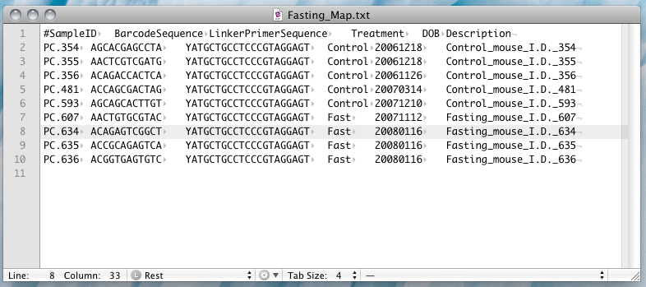
Mapping file

Slide 2
Mapping file: always run validate_mapping_file.py
= required field

Slide 3
What mapping validation checks
Is your first column called #SampleID?
Are the sample ids unique?
Is BarcodeSequence second?
Are the Barcode Sequences Unique?
Is your third column LinkerPrimerSequence?
Is your last column Description?

Slide 4
What mapping validation doesn’t check
Do you have the metadata columns you need to do your analysis?
Do you have the data associated with those columns?
Are items in your metadata spelled consistently or correctly?
Are units consistent between metadata entries?
Is your metadata associated with the correct sample?

Slide 5
What else you may need
Data about your host or collection site
Where they came from
Physical health of the host
Chemical properties of the Host
Information about your sequencing process
Who did the extraction; what protocol they used
What lot of extraction reagents were used
Which sequencer was used

Slide 6
Best Practices
Collect metadata during the experiment
Collect lots of metadata. It’s easier to ignore data, it’s hard to get data you’re missing
Store the metadata in separate columns “Description” should be redundant
Have a nearly complete mapping file before sequencing Knight Lab does not sequence samples without metadata.

Slide 7
Missing mapping file
From: XXXX@gmail.com
To: qiime-forum@gmail.com
Subject: mapping file
Hi,
I am doing microbial analysis with QIIME. I got the SFF files back from the sequencing center, but I lost the mapping file. Can you help me please?
Thanks,
XXXX
HT to Dr. Clemente for sharing this e-mail

Slide 9
QIIME Pipeline

Slide 10
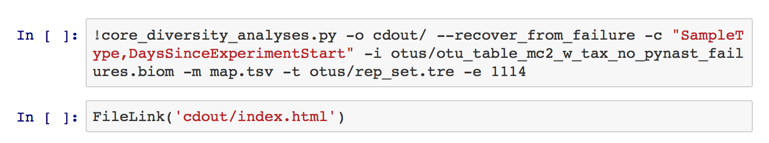
Command Cell

Slide 11
Examining Ecological Communities
Taxonomy What is present?
Alpha Diversity How different is the community?
Beta Diversity Does this community look like that one?
Interactions How does this community influence it’s environment?
3 humans
1 human
2 fish
1 human
2 cats
1 human
1 human
1 cat
1 fish

Slide 12
Alpha Diversity
2 Humans
2 Dogs
3 Humans
1 Fish
2 Humans
1 Dog
1 Fish
4 Humans
1
<
2
=
2
<
3

Slide 13
Alpha Diversity
What if we account for the abundance of each species?

Slide 14
Unweighted and Weighted Metrics
Unweighed Metrics
Weighted Metrics
Presence/Absence of an OTU
More sensitive to rare OTUs
Observed Species, PD Whole Tree
Unweighted UniFrac Bray Curtis Distance, Euclidian Distance
Considers relative abundance (composition)
More sensitive to abundant taxa
Shannon Evenness
Weighted UniFrac
The Metrics are Complementary!

Slide 15
Alpha Diversity
What if we account for the abundance of each species?
Lots of one species → Less Diversity
<

Slide 16
Alpha Diversity
Could we improve our measure using similarity between community members?

Slide 17
Taxon vs Phylogenetic Metrics
Taxonomic
Phylogenetic
Assume everything is equally dissimilar
More likely to see differences based on close relatives
Shannon, Observed Species Bray Curtis, Eculian
Take into account similarity based on shared evolution
Better for scaling the differences which are seen
PD Whole Tree; UniFrac

Slide 18
Phylogenetic Alpha Diversity

Slide 19
Phylogenetic Alpha Diversity
<
<
<

Slide 20
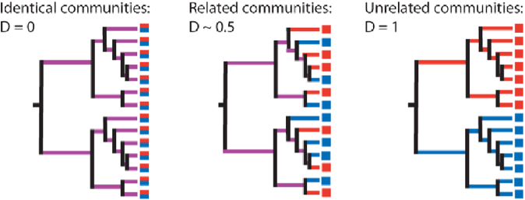
Unweighted UniFrac
Identical communities
D = 0.0
Related communities
D ~ 0.5
Unrelated communities
D = 1.0
Lozupone and Knight, 2005, Appl Environ Microbiol 71, 8228
Notes:
----- Meeting Notes (10/15/14 17:49) -----
Technical replicates
Different days
Sites

Slide 21
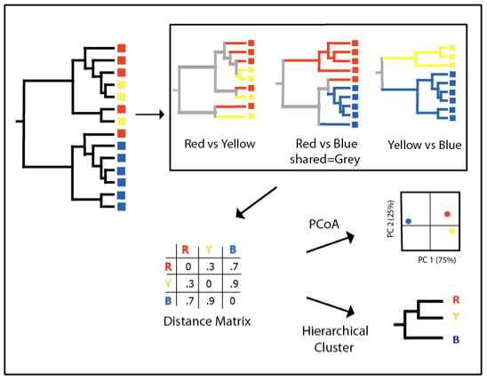
Clustering by UniFrac
Lozupone and Knight, 2005, Appl Environ Microbiol 71:8228
Notes:
Spend more time on this slide explaining the PC

Slide 22
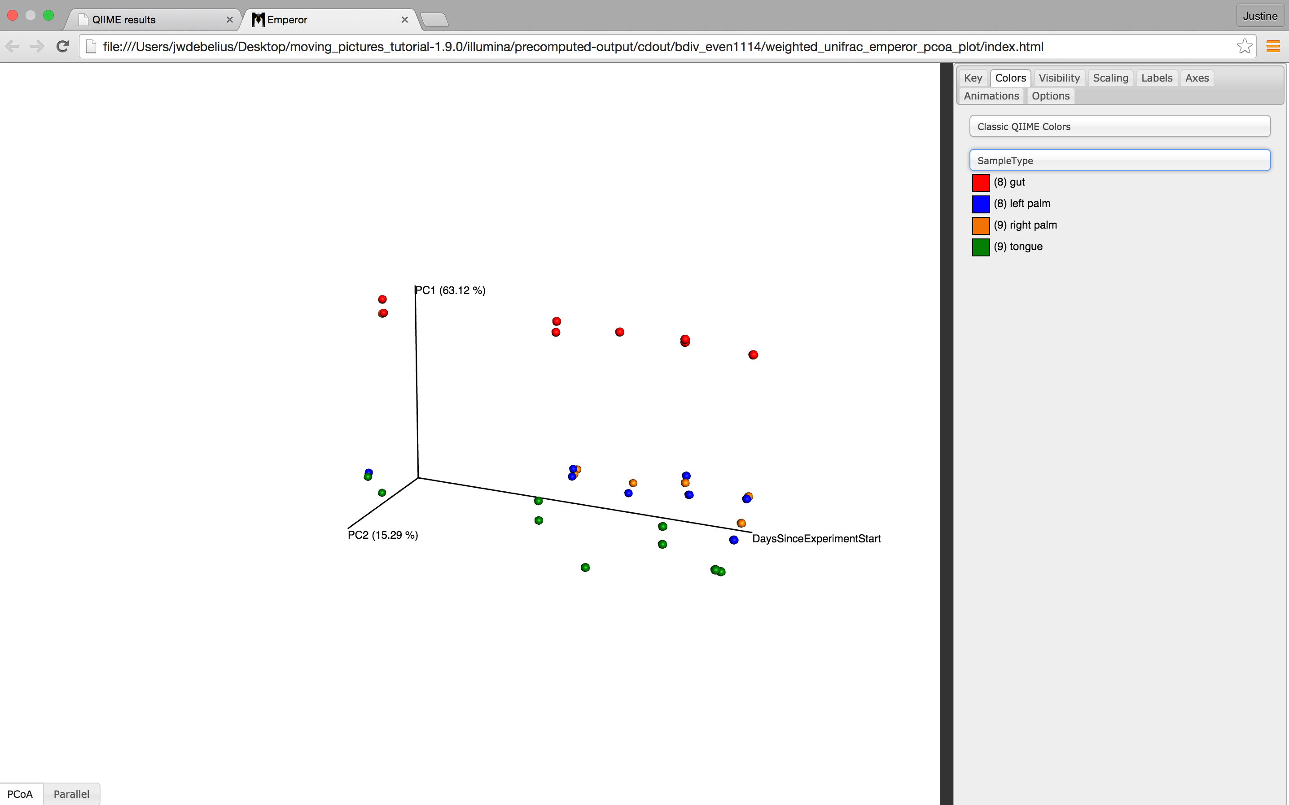

Slide 23
Things to Consider for Diversity
Metrics
Metrics Matter
We recommend PD Whole Tree Diversity and UniFrac Distance
Rarefaction Depth

Slide 24
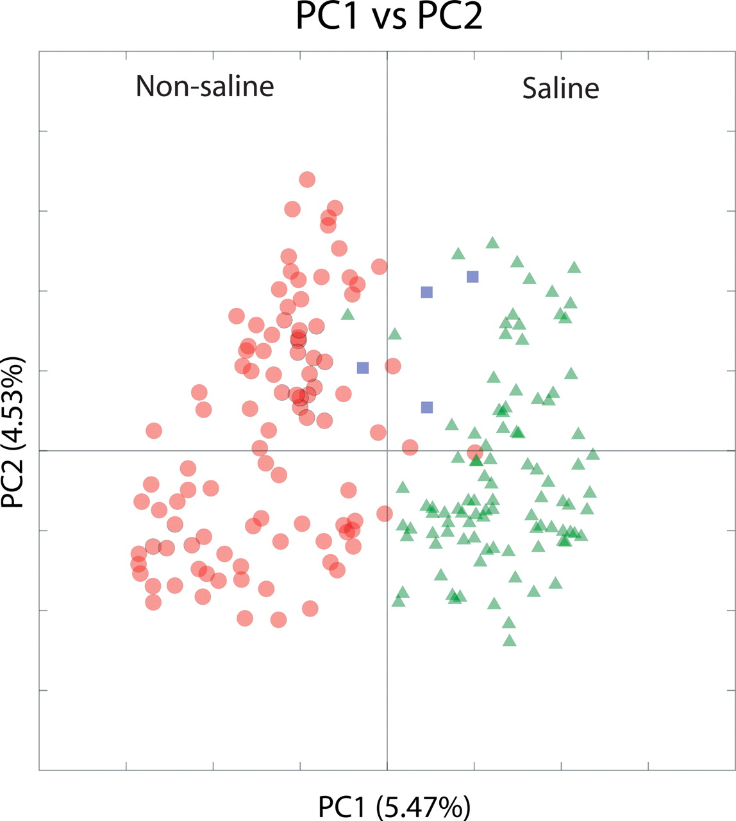
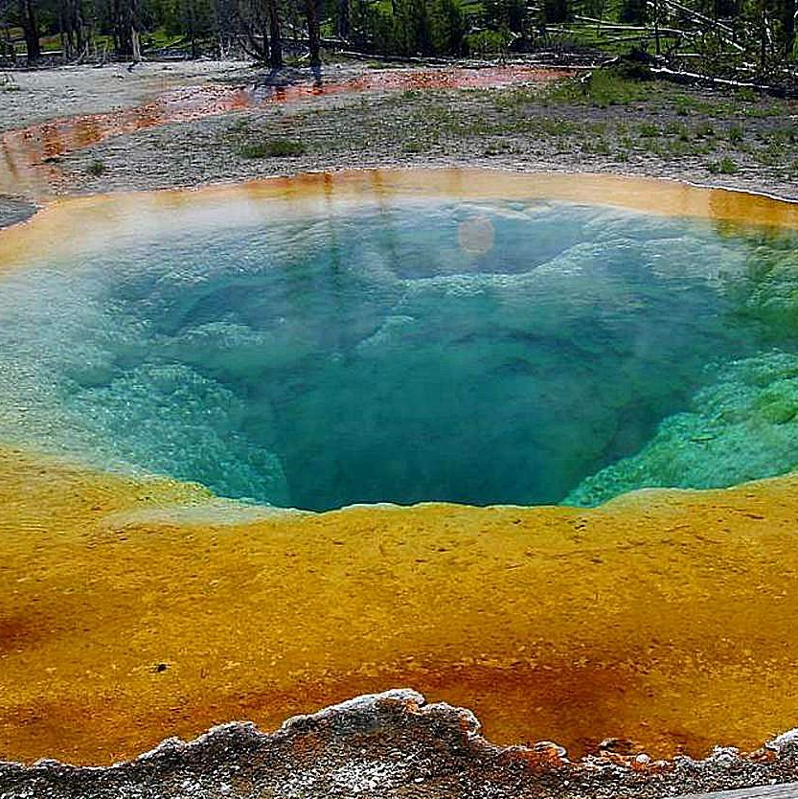
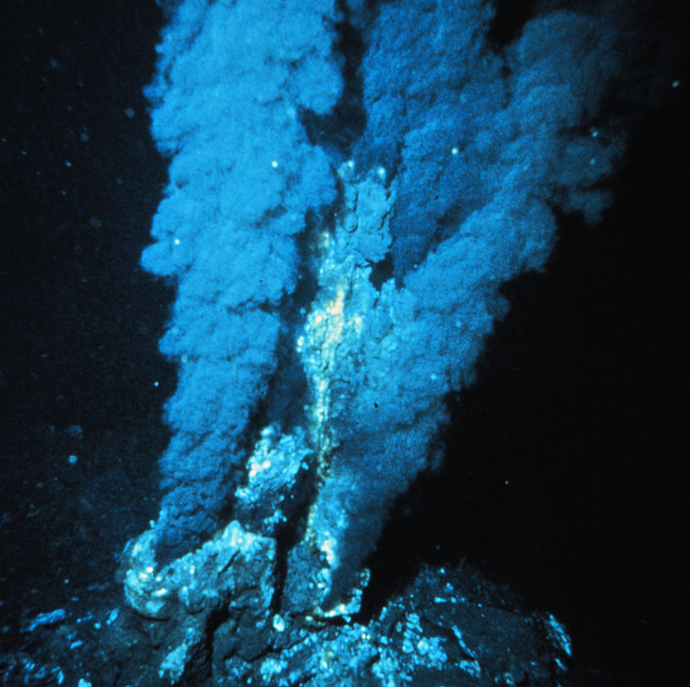
Salinity is a biologically relevant phenomenon
Non-saline
Saline
Mixed
Lozupone C, and Knight R (2007) PNAS 104:11436-11440

Slide 25
But, if we change the metric, the pattern goes away
UniFrac
Kulczynski
Euclidian
Micah Hamady (data from Lozupone and Knight 2007 PNAS)
Notes:
Things are obvious to me are not obvious to everyone.
Be explcit, they won’t feel stupid!!! Assume infinate intelegence and minimal knoweldge.

Slide 26
Things to Consider for Diversity
Metrics
Metrics Matter
We recommend PD Whole Tree Diversity and UniFrac Distance
Rarefaction Depth

Slide 27
Rarefaction
OTU
Remove Samples which do not have enough sequences
2. Randomly draw OTUs until you get to the threshhold

Slide 28
Rarefaction
OTU
Remove Samples which do not have enough sequences
2. Randomly draw OTUs until you get to the threshhold

Slide 29
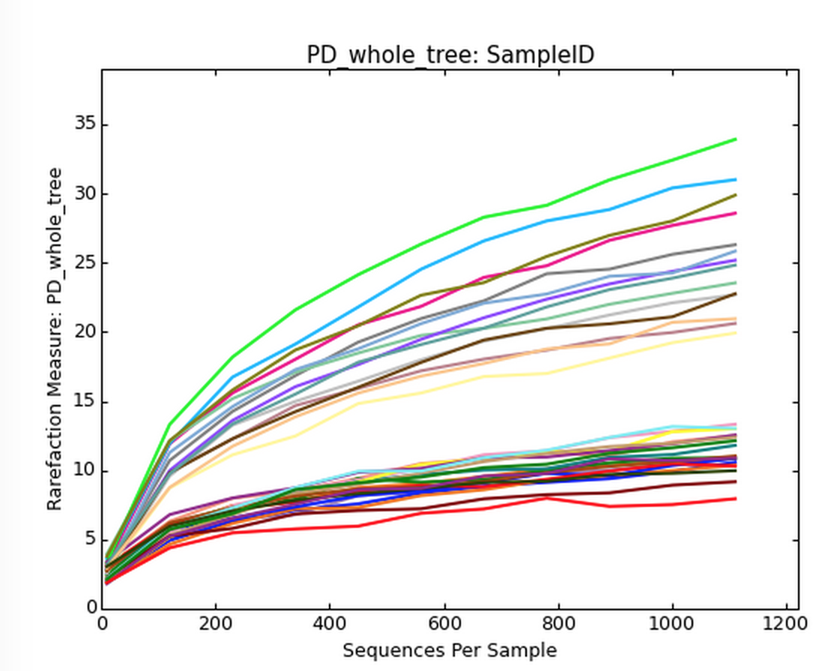
Alpha Rarefaction Plots
Perform repeated rarefactions, then measure alpha diversity
Useful for estimating an appropriate rarefaction depth
Ideally, the curve plateaus

Slide 30
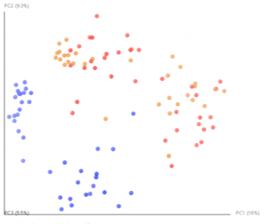
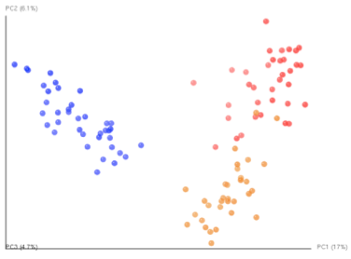
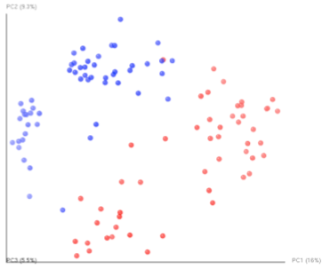
Rarefaction Matters for Beta Diversity!
Colored by individual
Either 50 or 500 seqs/sample
Colored by individual
500 seqs/sample
Color by rarefaction level
Either 50 or 500 seqs/sample

Slide 31
Things to Consider for Diversity
Metrics
Metrics Matter
We recommend PD Whole Tree Diversity and UniFrac Distance
Rarefaction Depth
Use alpha rarefaction to find your depth
Use a consistent depth across samples

Slide 32
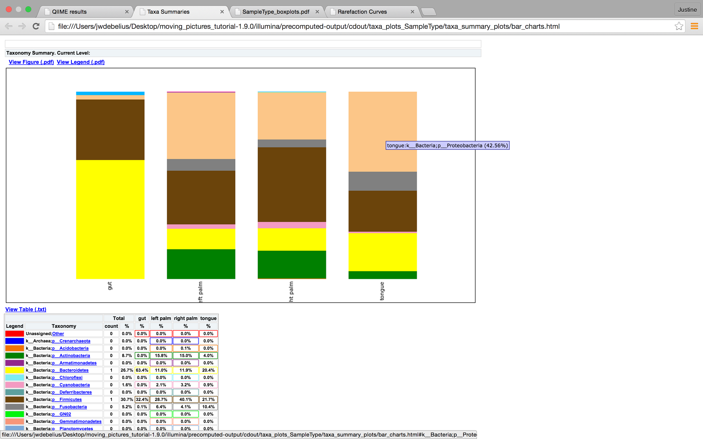
Taxonomy Analysis

Slide 33
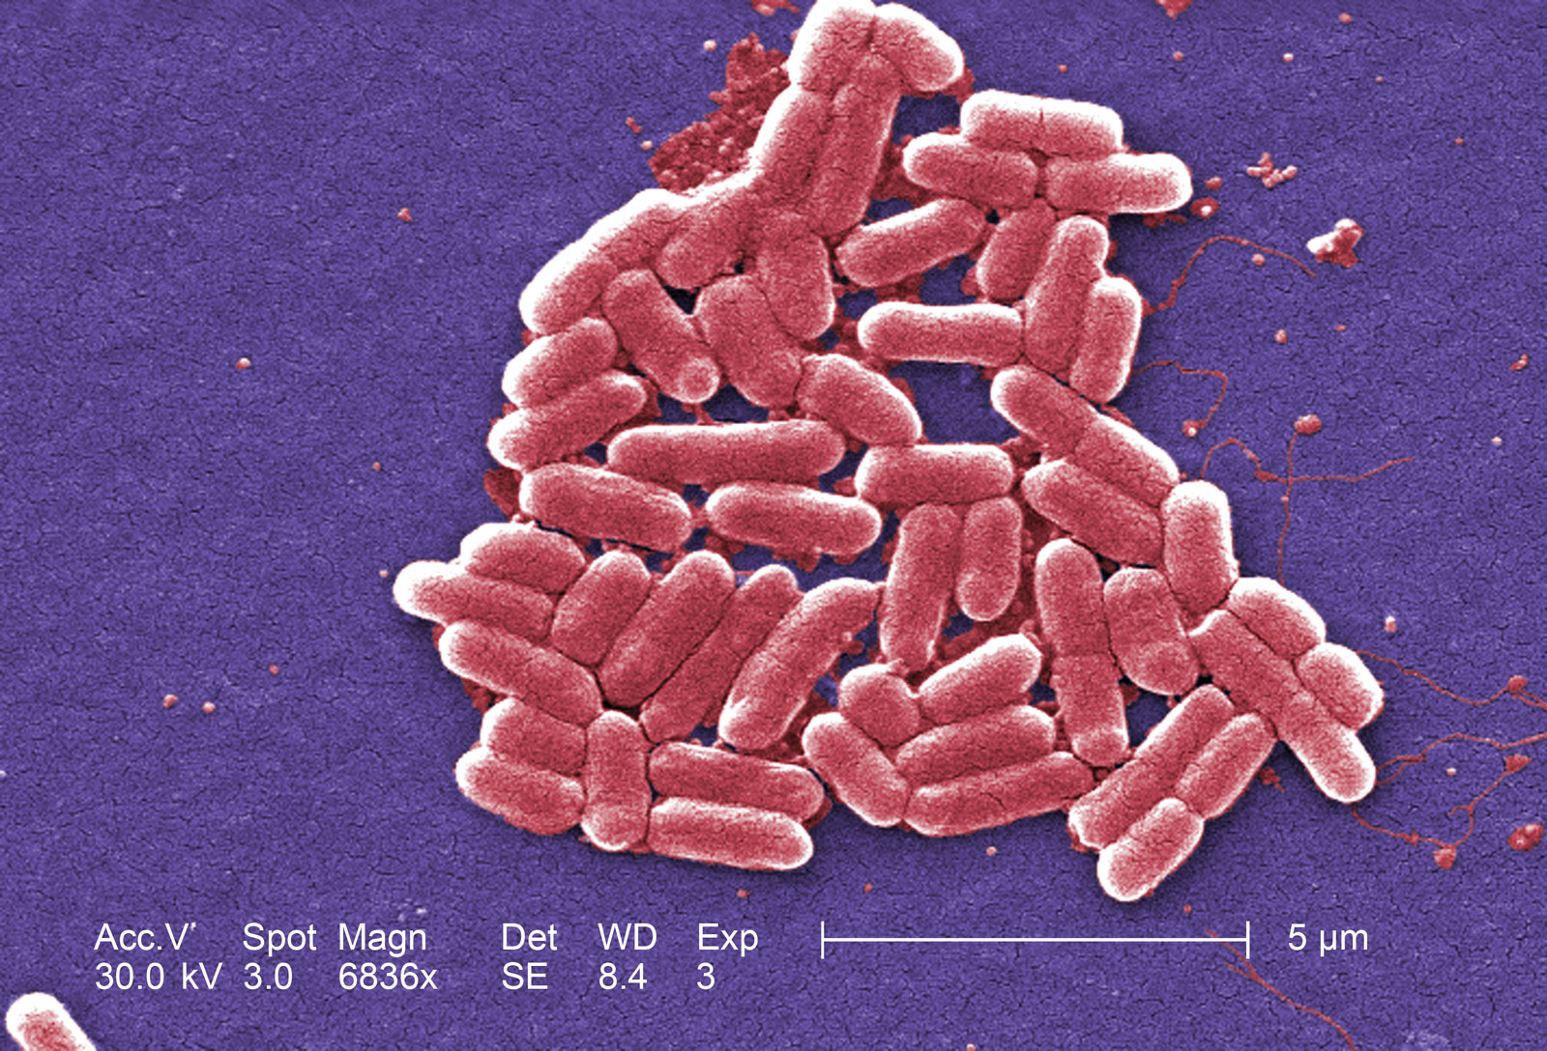
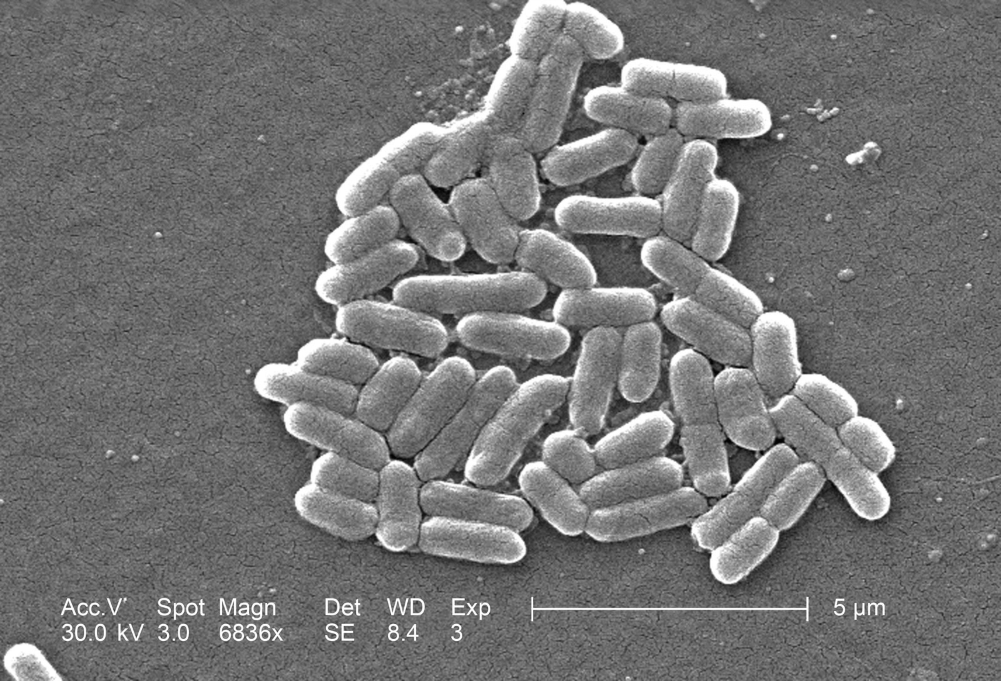
 | Ideal 16S | Real 16S
Kingdom | Bacteria | Bacteria
Phylum | Proteobacteria | Proteobacteria
Class | Gammaproteobacteria | Gammaproteobacteria
Order | Enterobacteriales | Enterobacteriales
Family | Enterobacteriaceae | Enterobacteriaceae
Genus | Eschericia | ---
Species | coli | OTU 2445338
Strain | O157:H7 | --
E. coli: http://media-3.web.britannica.com/eb-media//87/141087-050-24850517.jpg
http://upload.wikimedia.org/wikipedia/commons/d/d3/Staphylococcus_aureus_VISA_2.jpg

Slide 34
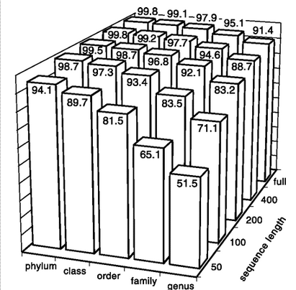
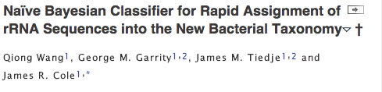
Length of sequences matter
Numbers are percentages of tests correctly classified.

Slide 35

Do you always need species level resolution?
Urząd Miejski w Trzebiatowie, Referat Promocji UM; 2007

Slide 36
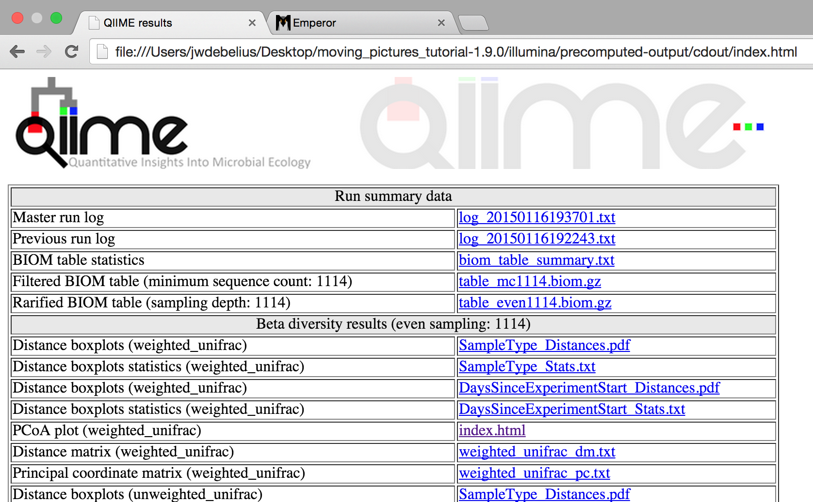

Slide 38
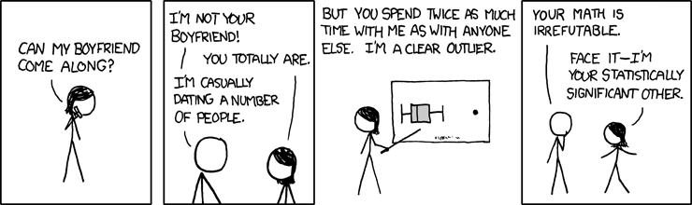
Testing for Statistical Significance
“Boyfriend”. XKCD (593).

Slide 39
Statistical Tests wrapped into QIIME
Alpha Diversity across groups
Beta Diversity across groups and continous
OTUs across groups
Predict metadata from OTUs

Slide 40
…So, you use a t-test?
A t-test is a parametric test. A t test, ANOVA, or Q-Q plot assumes normal data.
Most variable associated with the microbiome are not normal or normality cannot be assumed.
Two options for nonparametric tests:
Traditional rank-sum tests (i.e. Mann-Whitney, Kolmogorov–Smirnov )
Permutative Statics (permanova)

Slide 41
Multiple hypothesis testing
For a critical value of 0.05, there is a 1/20 change of randomly finding a distribution
Multiple hypothesis testing can correct this problem
QIIME usually offers Bonferroni and/or FDR

Slide 43
Other things that you may be interested in…
Random Forests
Metagenomic Predictions
Power Analysis

Slide 44
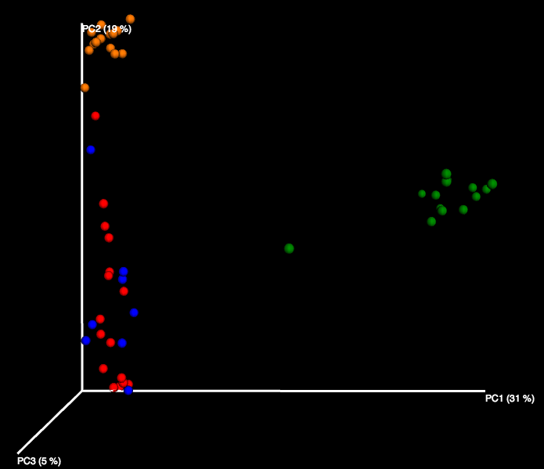
Should my sample really be there?

Slide 45
Should my sample really be there?

Slide 46
Should my sample really be there?

Slide 47
Supervised learning random forests
Can you tell your sample classes apart?
One of many machine learning strategies available
What does it tell you?
Whether or not you samples are separated by a group of features
What the inter and intra-class variation looks like

Slide 48
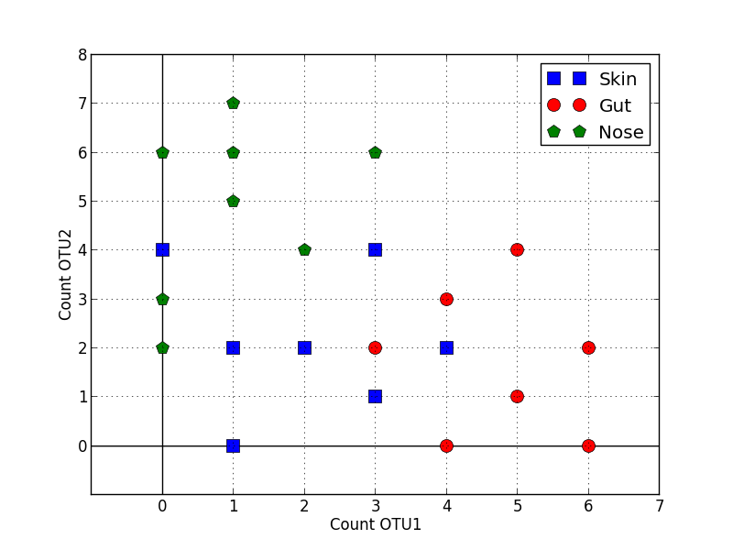
How does it work?

Slide 49
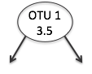
How does it work?

Slide 50
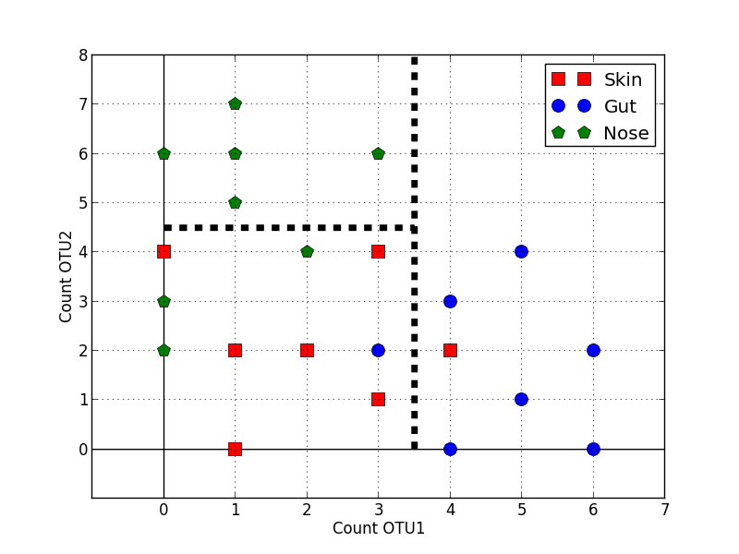
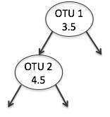
How does it work?

Slide 51
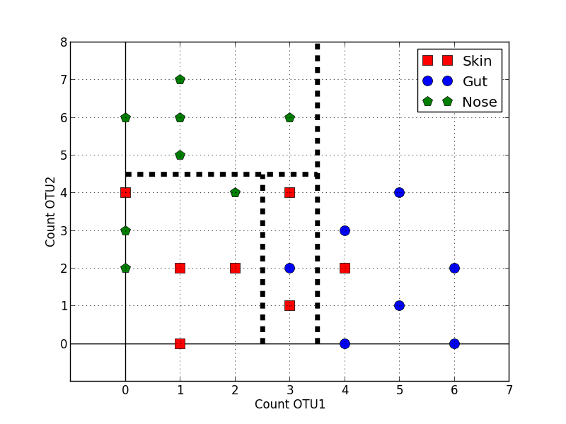
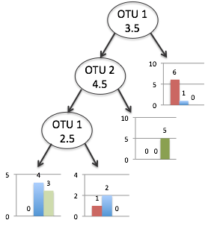
How does it work?

Slide 52
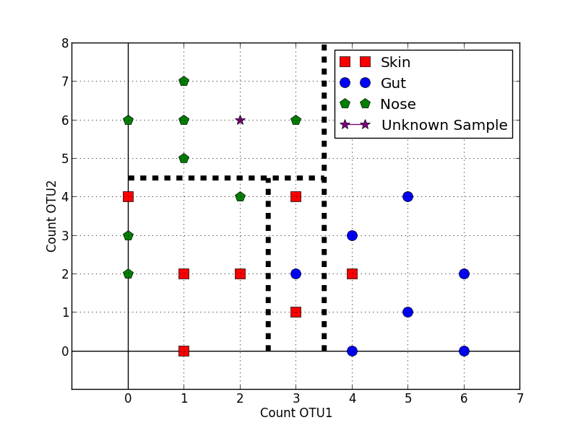
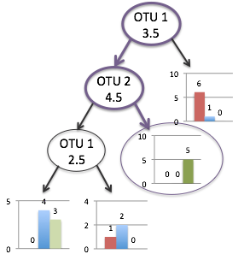
How does it work?

Slide 53
How to run it in qiime?
http://qiime.org/tutorials/running_supervised_learning.html

Slide 54
Metagenomic Prediction
Metagenomics are expensive
Sometimes, you want to try an old dataset
PICRUSt allows prediction

Slide 55
PICRUSt
http://picrust.github.io/picrust/
Nearest Sequenced Taxon Index (NSTI): how good the predictions are, the lower the better.
Really well characterized human body sites you get 0.03 ± 0.02 s.d.
Hypersaline mat microbiome: 0.23 ± 0.07 s.d.

Slide 56
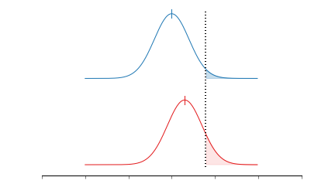
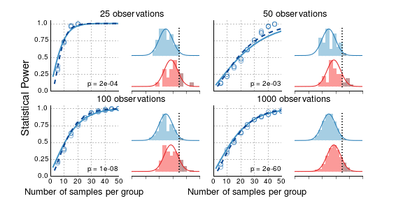
Statistical Power Do I really need that many samples?
If we know there is a difference in the underlying population, and we draw subsamples, how many samples do we need to draw to see that difference?
Notes:
Rather than traditional

Slide 57
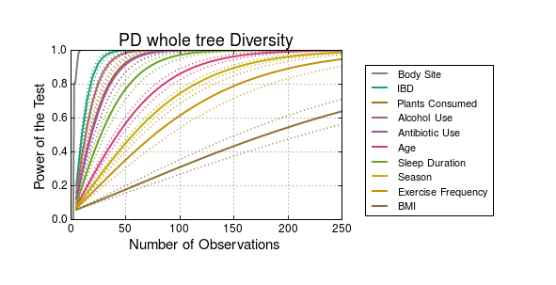

Slide 58

Power curves can be run through
Example Code:
http://nbviewer.ipython.org/github/biocore/American-Gut/blob/master/ipynb/Power.ipynb

